Slide 1

Defending the Crown: Keytruda’s 2028 LOE & Merck’s Next-Generation Oncology Strategy
- Keytruda’s 2028 LOE creates a significant franchise transition, requiring Merck to simultaneously defend the existing franchise and accelerate the next generation of oncology growth
DEFEND
ACCELERATE
REPLACE

Slide 2
Keytruda LOE: Defend the Franchise, accelerate the pipeline
1 | Revenue Exposure
Keytruda contributes 57 % of Merck Pharma revenue: estimated $ 96.6 Billion (2015 – 2025) could be exposed to post – LOE erosion
02 | Clinical Response
Relevant pembrolizumab programs create opportunities across multiple disease areas with key clinical milestones extending through 2028.
03 | Portfolio transition
Next – generation oncology assets could provide replacement growth: timing and probability remain the critical constraints.
Strategic question
Can Merck offset Keytruda post- 2028 erosion by defending the existing franchise while accelerating the next generation of oncology growth ?

Slide 3
Keytruda is a portfolio-level concentration for Merck
01 | Keytruda Revenue
$8.4B | FY 2026
02 | YoY growth
+4% | FY 2026
03 |Major geography
North America
04 | Share of Merck’s Pharma Revenue
~56.8%

Slide 4
Keytruda’s value is distributed across a broad oncology franchise
01 | Largest opportunity
Indication: NSCLC Market | Revenue: $ 10.2 Bn
(2024)
02 | Fastest growth
Indication: Triple negative breast cancer
Growth: 5.0 – 5.5 % CAGR (2025 – 2032)
03 | Highest LOE sensitivity
Indication: NSCLC
Rationale: Revenue dependency: 34.6%

Slide 5
Keytruda’s protection landscape creates a 2028- 2031 transition window
01 | Core U.S Patent
Primary composition –of-matter patent expires Dec 2028, opens door to biosimilar competition
02 | Additional protection
Two composition patents extend to May/Nov 2029 → 1 – year litigation buffer before biosimilar entry
03 | Indication-specific exclusivity
Some orphan indication extend beyond 2028, additional runway for selected uses.
2026
2027
2028
2029
2030
2031
Current Year
Key Phase 3 Readouts
Core Patent expires
Biosimilar entry
Orphan drug exclusivity ends
Potential extension
Clinical Milestone
Endometrial Cancer (KEYNOTE‑C93) - expected completion May 2027
Pediatric Solid Tumors/Lymphoma (KEYNOTE‑051) – completion Feb 2028.
Esophageal Cancer (MK‑3475‑06F) – completion June 2028.

Slide 6
The Key economic question is how much Keytruda revenue is exposed after 2028
01 | 2028 Revenue
$ 35.0 B
(Global Keytruda baseline)
02 | 2030 Revenue at Risk
$ 10.9 B
03 | Cumulative Exposure
(2029 – 2031)
$ 29.7 B

Slide 7
Keytruda: Multi-lever franchise defence strategy
01 | Differentiate
Protect the franchise through differentiated delivery
QLEX/ sc administration
Faster administratiob and differentiated patient experience
Creates a differentiated formulation alongside IV keytruda
02 | Move earlier
Capture patients before advanced diseases.
Perioperative /adjuvant expansion
Move Keytruda from treatment around surgery
Increase duration and breadth of franchise exposure
Example: Perioperative bladder cancer
03 | Build combination franchises
Make Keytruda the backbone- not just the molecule
Keytruda + Complementary mechanisms
Chemotherapy
Targeted therapies / ADCs
Novel immunotherapies
Build durable treatment franchises around pembrolizumab
04 | Expand
Increase the addressable patient population
NEW TUMORS
Expand into additional cancer types
NEW LINES
Earlier / later lines of therapy
NEW POPULATION
Biomarker – defined and underserved populations
Tumor types -> Treatment lines -> Patient segments

Slide 8
Pembrolizumabs clinical pipeline provides multiple routes to franchise expansion
NCT Number / Trial ID | Indication | Phase | Status | Completion | Strategic Role
NCT05173987 | Endometrial Neoplasms | PHASE 3 | ACTIVE_NOT_RECRUITING | 27-05-2027 | EXPAND
NCT03765918 | Endometrial Neoplasms | PHASE 3 | ACTIVE_NOT_ RECRUITING | 27-05-2027 | MOVE EARLIER
NCT03713593 | Carcinoma, Hepatocellular | PHASE 3 | COMPLETED | 24-09-2024 | COMBINE

Slide 9
The post Keytruda strategy depends on the broader Merck oncology pipeline
01 | Phase III/Filing – visible assets
Programs with the maturity and strategic fit to contribute around 2028 LOE window
→ ACCELERATE
02 | Phase II Assets with differentiated opportunity
Programs that create meaningful franchise value beyond the immediate LOE Window.
→ BUILD
03 | Early- stage Platforms / mechanisms
Higher-uncertainty programs that could create future oncology growth platforms
→ SELECT / MONITOR

Slide 10
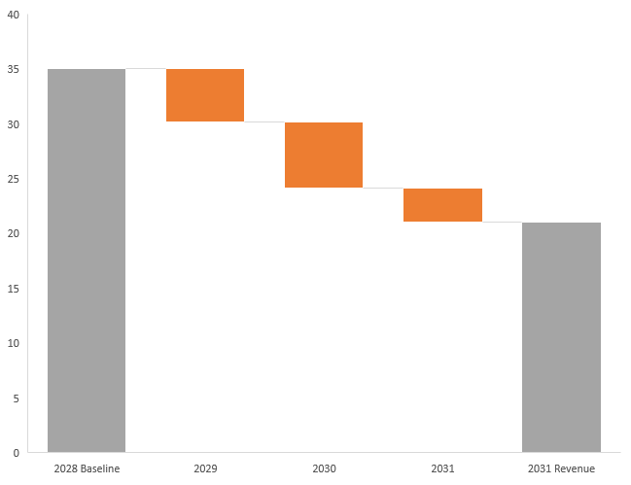
KEYTRUDA’s 2028 U.S. LOE could create a $ 14 B annual revenue Gap by 2031, Requiring multiple replacement Engines
Replacement pathways
01 | Extend
Keytruda Lifecycle
Near-term
02 | Build
New Oncology Growth Engines
Mid- term
03 | Develop
Future Oncology Options
Long - term
Implication: Merck needs a portfolio of replacement engines rather than a one-for-one successor to Keytruda
$ 35. 0 B
- $4.9 B
- $6. 0 B
- $3. 1 B
$21.0 B
~ $14 B
Annual gap by 2031
$29. 7 B
Cumulative 2029 – 2031 exposure

Slide 11
R&D prioritization should focus on mature high value programs
NCT04657991
NCT05085028
NCT02954874
NCT06430866
NCT06984588
Prioritise mature programs with meaningful commercial value and near –term relevance to the LOE window
SELECTIVE
PRIORITIZE
NCT06907602
NCT05173987
NCT04221945
MONITOR
ADVANCE
NCT06923475

Slide 12
Keytruda’s protection landscape creates a 2028- 2031 transition window
DEFEND → ACCELERATE → REPLACE
01 | Defend
Extend Keytruda runway
2026 – 2028
Differentiate through QLEX
Expand indications and patient populations
Move Keytruda earlier in treatment
Protect near –term franchise value
02 | Accelerate
Convert the pipeline into growth
2027 – 2030
Advance mature, commercially relevant programs
Build combination- led franchises
Prioritize opportunities with near term impact
Bridge the post-LOE revenue gap
03 | Replace
Build the next oncology engines
2029 – 2031+
Develop differentiated mechanisms
Scale next-generation oncology platforms
Reduce dependence on a single blockbuster
Create multiple post-Keytruda growth engines

Slide 13
Keytruda’s LOE is a portfolio transition – not a single asset replacement challenge
PROTECT THE CORE
Continue lifecycle expansion through differentiated delivery, new indications, earlier use and combinations
CONCENTRATE INVESTMENT
Prioritize mature programs with meaningful commercial opportunity and relevance to the 2028 – 2031 transition.
DIVERSIFY THE FUTURE
Build multiple oncology growth engines across mechanisms and modalities rather than seeking one successor.

